Slide 1
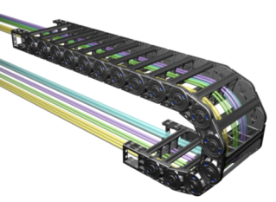
CPS Chain Compare List
1

Slide 2
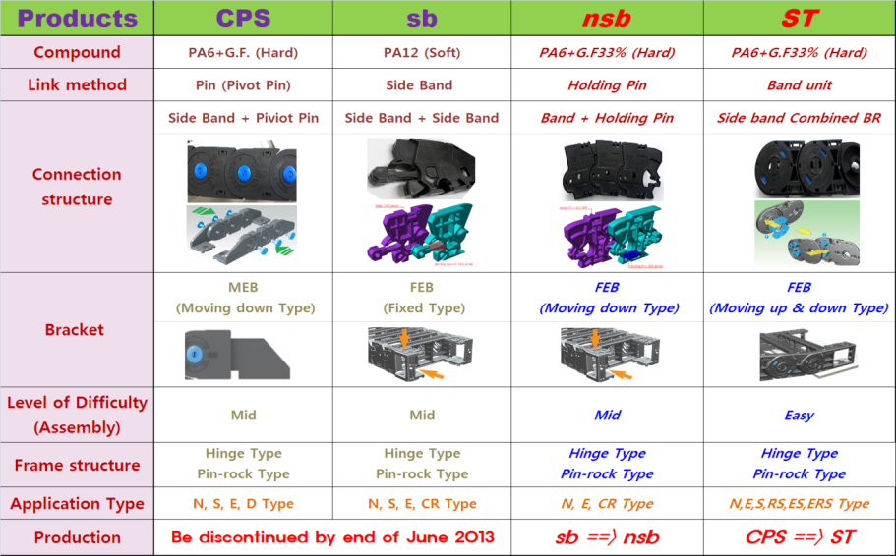
CPS Chain compare list
Stop
production
2

Slide 3
CPS ➔ ST
3

Slide 4
CPS ➔ ST
4

Slide 5
sb ➔ nsb
Stop production
5

Slide 6
sb ➔ nsb
Stop production
6

Slide 7
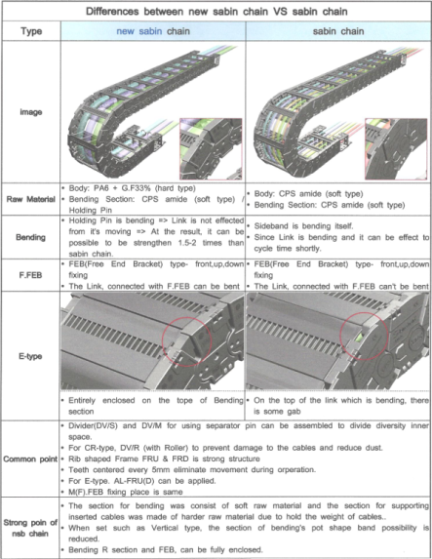
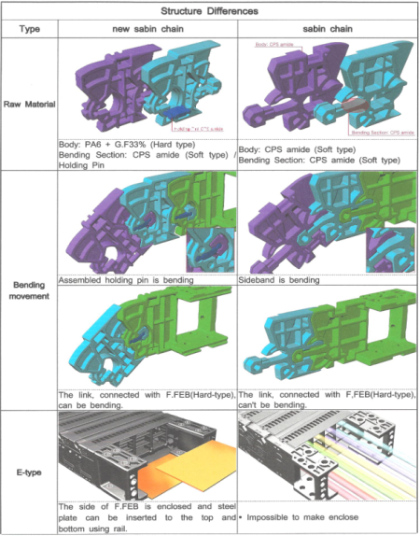
sb ➔ nsb
7

Slide 8
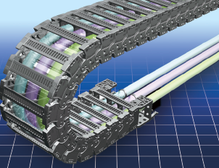
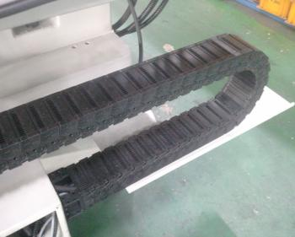
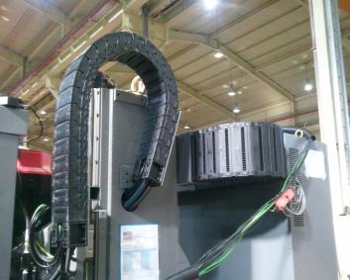
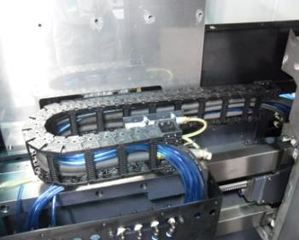
nsb application pictures
nsb chain
8

Slide 9
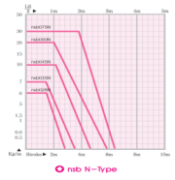
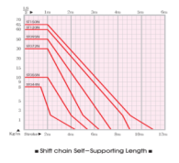
nsb compare to ST
9

Slide 10
CPS Overseas sales dept
Thank you and Good day
Team leader JW Heo
10

